Slide 1
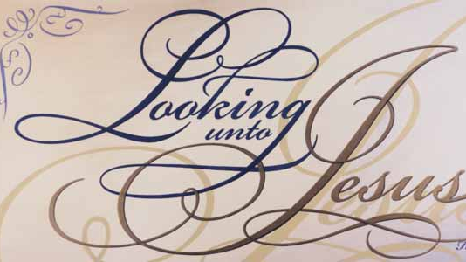
April Lesson Series

Slide 2
Hebrews 12:1-2
Lesson Three

Slide 3
Therefore we also, since we are surrounded by so great a cloud of witnesses, let us lay aside every weight, and the sin which so easily ensnares us, and let us run with endurance the race that is set before us, looking unto Jesus, the author and [finisher of our faith, who for the joy that was set before Him endured the cross, despising the shame, and has sat down at the right hand of the throne of God.
Hebrews 12:1-2

Slide 4
I have fought the good fight, I have finished the race, I have kept the faith. Finally, there is laid up for me the crown of righteousness, which the Lord, the righteous Judge, will give to me on that Day, and not to me only but also to all who have loved His appearing.
II Timothy 4:7-8

Slide 5
Be thou faithful unto death, and I will give thee the crown of life.
Revelation 2:10

Slide 6
The Greek word for looking is "aphorao," It means "to look away from anything or anyone else." To fix one’s eyes on.

Slide 7
1. Forgetting the Present Atmosphere.
Philippians 3:13

Slide 8
“Brethren, I do not count myself to have apprehended; but one thing I do, forgetting those things which are behind and reaching forward to those things which are ahead.”
Philippians 3:13

Slide 9
A. Looking Away from Our Past Sins.

Slide 10
For He made Him who knew no sin to be sin for us, that we might become the righteousness of God in Him.
I Corinthians 5:21

Slide 11
So Christ was offered once to bear the sins of many. To those who eagerly wait for Him He will appear a second time, apart from sin, for salvation.
Hebrews 9:28

Slide 12
B. Looking Away from Our Self-life.

Slide 13
I have been crucified with Christ; it is no longer I who live, but Christ lives in me.
Galatians 2:20

Slide 14
Whoever loses his life for My sake will find it!”
Matthew 16:5

Slide 15
Five Ways to Embrace the Cross:
1. Humiliation
2. Rejecting the praise of men
3. Embracing simplicity and child-likeness
4. Living by pure faith
5. Seeking our nothingness and His all-ness

Slide 16
2. Focusing Our Attention.

Slide 17
A. An Unblurred Focus.

Slide 18
B. An Unbroken Focus.

Slide 19
C. An Unblocked Focus.

Slide 20
Five Ways To Stay Focused On God:
Begin your day with prayer
Remain in prayer
Limit the distractions
Serve God
Remove sin from your life

Slide 21
3. Fastening Our Affection.
Colossians 3:1-2

Slide 22
“If ye then be risen with Christ, seek those things which are above, where Christ sitteth on the right hand of God. Set your affection on things above, not on things on the earth.”
Colossians 3:1-2

Slide 23
A. Jesus, The Liberator.

Slide 24
For the law of the Spirit of life in Christ Jesus hath made me free from the law of sin and death.
Romans 8:2

Slide 25
B. Jesus, The Originator.

Slide 26
I am the Alpha and the Omega, the First and the Last, the Beginning and the End.
Revelation 22:13

Slide 27
C. Jesus, The Perfecter.

Slide 28
D. Jesus the Mediator

Slide 29
For there is one God and one mediator between God and men, the man Christ Jesus.
I Timothy 2:5

